Slide 1
Weather Data Analysis & Visualization
Name : Rifana . A
Date: 4.5.2025

Slide 2
Introduction
Weather data contains valuable insights
Python helps clean and analyze the data
Power BI turns that analysis into interactive visuals
Goal: Combine both for better understanding

Slide 3
Objectives
Goal : To build an interactive and insightful weather analysis dashboard by combining Python (for data cleaning and analysis) and Power BI (for data visualization).
Clean and Prepare Weather Data using Python
Analyze Key Weather Factors
Create Interactive Dashboards in Power BI

Slide 4
Dataset
Source: The dataset was collected from Kaggle
Total Records:80617 rows ,23 columns
Key attributes : Location, MinTemp, MaxTemp, Rainfall, Humidity9am, Humidity3pm, WindGustDir, WindGustSpeed, WindDir9am, WindDir3pm,Temp9am, Temp3pm, RainToday, RainTomorrow.
Data Type : Structured data (tabular), Format: CSV , Includes text, numeric, and categorical values.
Challenges: Missing values in temperature, humidity, wind, and pressure fields
Imbalanced categories in RainToday and RainTomorrow.

Slide 5
Methodology
Load Dataset
Weather data (CSV format) was loaded into Power BI for visualization
Also explored and cleaned in Python
Data Cleaning & Preprocessing
Data Visualization
Added Slicers & Interactivity
Data Collection (Kaggle)
⬇
Preprocessing (Python)
⬇
Visualization (Power BI)
⬇
Interactive Dashboard

Slide 6
Model Selection & Implementation
Machine Learning Models Applied:Linear Regression,Random Forest Regressor,XGBoost Regressor,Support Vector Regressor (SVR),K-Nearest Neighbors (KNN).
Linear Regression ➤ Simple baseline model for understanding linear relationships
Random Forest Regressor ➤ Powerful ensemble model that reduces overfitting ➤ Works well with large datasets and handles non-linearity
XGBoost Regressor
➤ Advanced boosting algorithm with high performance ➤ Good for handling complex patterns and fine-tuning
SVR (Support Vector Regressor) ➤ Works well for small datasets but sensitive to scaling
KNN Regressor ➤ Simple, instance-based learner ➤ Useful for capturing local patterns
Training Process:
Train-Test Split: ➤ 80% Training – 20% Testing
Evaluation Metrics:
MAE (Mean Absolute Error)
RMSE (Root Mean Squared Error)
R² Score (Coefficient of Determination)
Best Performing Model: XGBoost (Highest R², Lowest RMSE & MAE)

Slide 7
Evaluation & Results
Metrics Used:
Since the project involves regression, the following metrics were used:
MAE (Mean Absolute Error): Measures average magnitude of error
RMSE (Root Mean Squared Error): Penalizes larger errors
R² Score (R-squared): Explains how well model predictions fit actual data
XGBoost Regressor performed the best with the lowest error and highest R² Score.

Slide 8
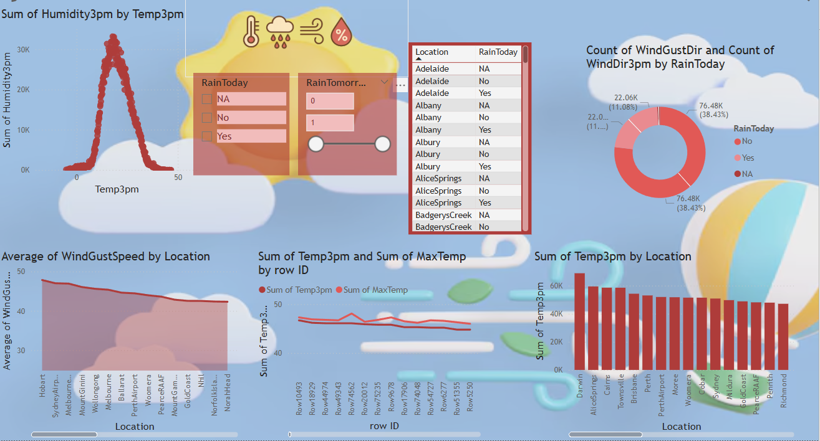
Dashboard Overview

Slide 9
Challenges
Outliers: Extreme values in rainfall and humidity affected model performance. Needed proper outlier removal.
Skewed Data: Some features were skewed, required transformation (e.g., log scale) for better distribution.
Categorical Variables: Converting wind directions to numerical using one-hot encoding increased dimensionality.

Slide 10
References
Dataset source : kaggle
Pandas, matplotlib,seaborn
xgboost

Slide 11
Thank you

